Slide 1
Combating Dissipation

Slide 2
Numerical Dissipation
There are several sources of numerical dissipation in these simulation methods
  Error in advection step
  Pressure projection (time splitting)
    Not addressed yet in graphics!
  Level set redistancing
Focus on the first

Slide 3
Dissipation Example (1)
Start with a function nicely sampled on a grid:

Slide 4
Dissipation Example (2)
The function moves to the left
(perfect advection) and is resampled

Slide 5
Dissipation Example (3)
And now we interpolate from new sample values, and ruin it all!

Slide 6
The Symptoms
For velocity:
  Too viscous or sticky (molasses), or at an implausible length scale (scale model)
  Turbulent detail quickly blurred away
For smoke concentration:
  Smoke diffuses into thin air too fast,
  nice sharp profiles or thin features vanish
For level sets:
  Water evaporates into thin air, bubbles disappear

Slide 7
High Order/Resolution Schemes
That said, we can do a lot better than
first-order semi-Lagrangian
High order methods: use more data points to get more accurate interpolation
  Cancel out more terms in Taylor series
  Problem: inevitably can give undershoot/overshoot (too aggressive)
  Stability for nonlinear problems?
High resolution methods: high order except near sharp regions

Slide 8
Sharpening semi-Lagrangian
Can also do better with semi-Lagrangian approach
Sharper interpolation
- e.g. limited Catmull-Rom [Fedkiw et al ‘02]
Estimating error and subtracting it
  BFECC [e.g. Kim et al ‘05]
Using derivative information
  CIP [e.g. Yabe et al. ‘01]

Slide 9
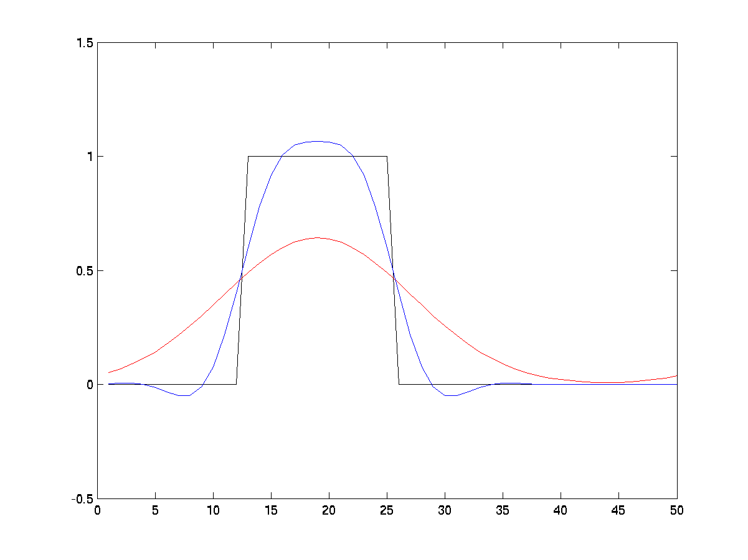
Example
Exact (particles) vs. 1st order vs. BFECC

Slide 10
Aside: resampling
Closely related to the sampling theorem:
frequencies above a certain limit cannot be reliably recovered on a grid
  Sharp features have infinitely high frequency!
Schemes which use an Eulerian grid as fundamental structure are inherently limited
(forced to use higher resolution than is strictly necessary)

Slide 11
Particle-in-Cell Methods
Back to Harlow, 1950’s, compressible flow
Abbreviated “PIC”
Idea:
  Particles handle advection trivially
  Grids handle interactions efficiently
  Put the two together:
  - transfer quantities to grid
  - solve on grid (interaction forces)
  - transfer back to particles
  - move particles (advection)

Slide 12
PIC
Start with particles
Transfer to grid
Resolve forces on grid
  Gravity, boundaries, pressure, etc.
Transfer velocity back to particles
Advect: move particles
Start with particles
Transfer to grid
Resolve forces on grid
  Gravity, boundaries, pressure, etc.
Transfer velocity back to particles
Advect: move particles
Notes:
Our algorithm begins with the particles carrying their velocity values (and any other fluid variables you might want).

Slide 13
PIC
Start with particles
Transfer to grid
Resolve forces on grid
  Gravity, boundaries, pressure, etc.
Transfer velocity back to particles
Advect: move particles
Start with particles
Transfer to grid
Resolve forces on grid
  Gravity, boundaries, pressure, etc.
Transfer velocity back to particles
Advect: move particles
Notes:
We then transfer the particle variables to a background grid, using weighted averages.

Slide 14
PIC
Start with particles
Transfer to grid
Resolve forces on grid
  Gravity, boundaries, pressure, etc.
Transfer velocity back to particles
Advect: move particles
Notes:
Then we do the standard force steps of a grid-based solver, such as solving for the pressure that makes the velocity field incompressible.

Slide 15
PIC
Start with particles
Transfer to grid
Resolve forces on grid
  Gravity, boundaries, pressure, etc.
Transfer velocity back to particles
Advect: move particles
Notes:
We then transfer the updated velocities back to the particles. Here there are two choices, PIC or FLIP, which I will explain later.

Slide 16
PIC
Start with particles
Transfer to grid
Resolve forces on grid
  Gravity, boundaries, pressure, etc.
Transfer velocity back to particles
Advect: move particles
Notes:
Finally we do advection: we move the particles in the new velocity field. Then we are ready for the next time step.

Slide 17
FLuid-Implicit-Particle (FLIP)
Problem with PIC: we resample (average) twice
  Even more numerical dissipation than pure Eulerian methods!
FLuid-Implicit-Particle (FLIP) [Brackbill & Ruppel ‘86]:
  Transfer back the change of a quantity from grid to particles, not the quantity itself
  Each delta only averaged once: no accumulating dissipation!
  Nearly eliminated numerical dissipation from compressible flow simulation…
Incompressible FLIP [Zhu&Bridson’05]

Slide 18
Where’s the Catch?
Accuracy:
  When we average from particles to grid, simple weighted averages is only first order
  Not good enough for level sets
Noise:
  Typically use 8 particles per grid cell for decent sampling
  Thus more degrees of freedom in particles then grid
  The grid simulation can’t see/respond to small-scale particle variations – can potentially grow in time
  Regularize: e.g. 95% FLIP, 5% PIC
  Can actually determine ratio which matches a particular physical viscosity!

